Slide 1
Capstone Project
--Solving Problems of University Students

Slide 2
1. Description
Determine the Problem
how to choose a good restaurant and a place for fun for a student in University of Toronto to spend weekend time.
Describe the Data
Wikipedia https://en.wikipedia.org/wiki/List_of_postal_codes_of_Canada:_M
the geographical coordinates http://cocl.us/Geospatial_data.
Foursquare API

Slide 3
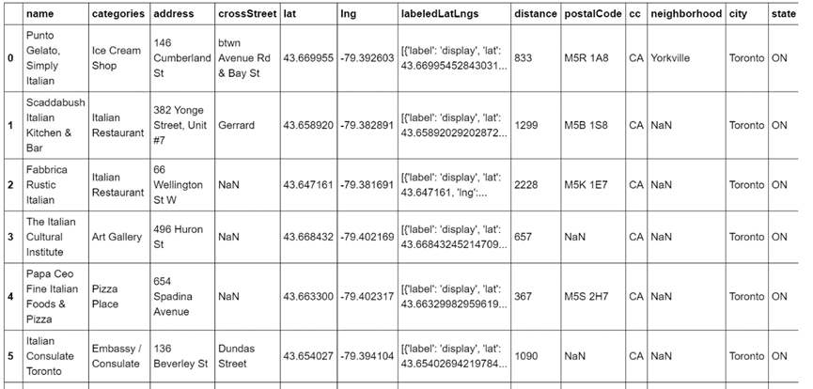
2. Evaluation of Restaurants
Load and analyze the data
the coordinates are 43.663461999999996, -79.39775965337452.

Slide 4
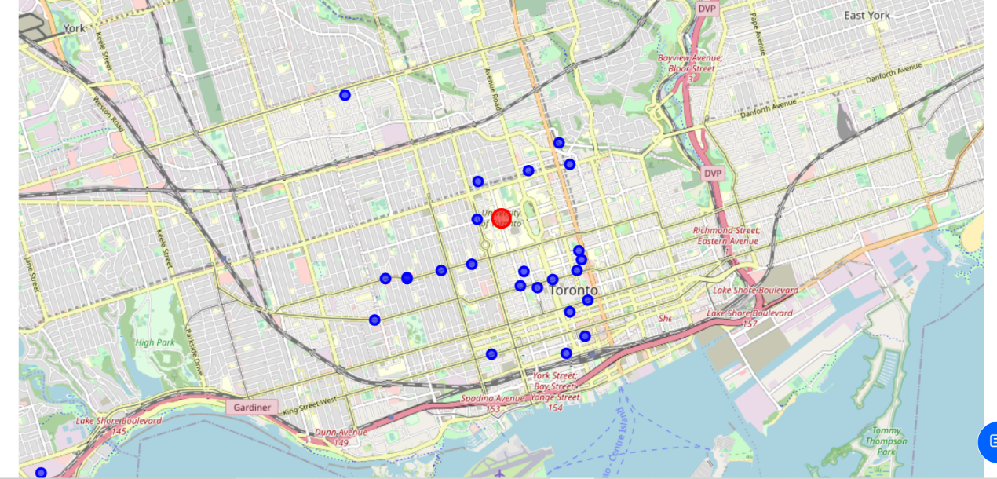
2. Evaluation of Restaurants
Visualization
the map of the restaurants around university of Toronto

Slide 5
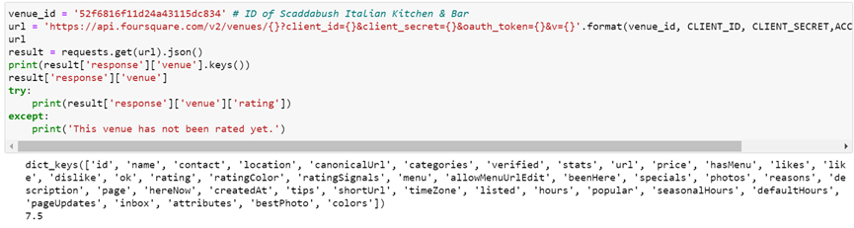
2. Evaluation of Restaurants
Further analysis
the rating of Scaddabush Italian Kitchen & Bar is the highest

Slide 6
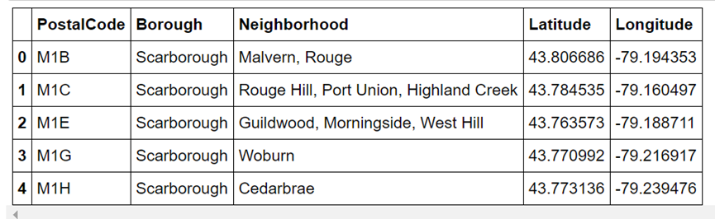
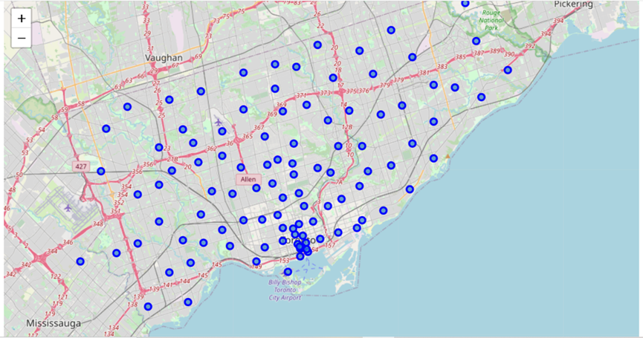
3. Evaluation of Places in Toronto
Load and prepare the data
Clustering Toronto areas

Slide 7
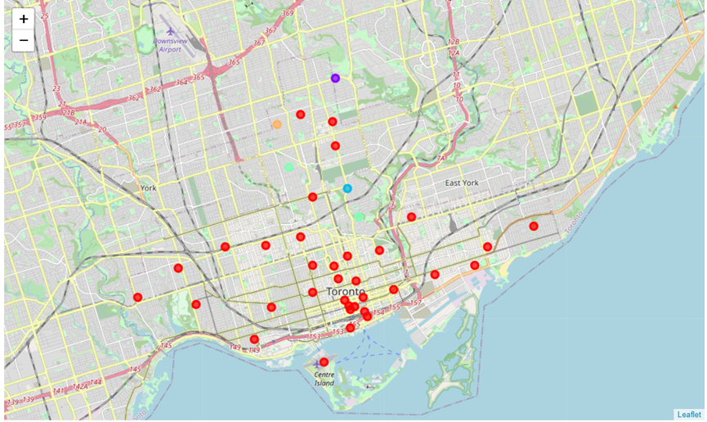
3. Evaluation of Places in Toronto
Check and choose a proper cluster

Slide 8
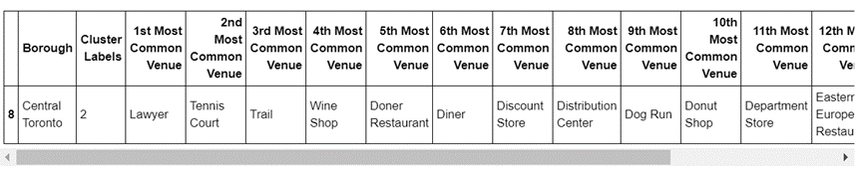
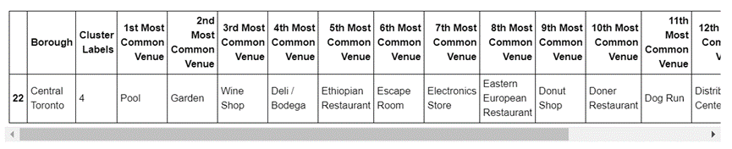
3. Evaluation of Places in Toronto
cluster 2 and cluster 4

Slide 9
4. Conclusion
In conclusion, if a student in university of Toronto wants to spend the time on weekend, Scaddabush Italian Kitchen & Bar is recommended because of its close distance and good ratings. Then Central Toronto and Downtown Toronto are recommended to visit.

Slide 10
Thank you!

